Slide 1
Value Investing Seminar #1:
Intro to Value Investing
October 5th, 2021
Ben Silvey
President, CIMG

Slide 2
Table of Contents
Introducing ourselves & CIMG
Value investing opportunities at UA
What is value investing?
Value investing today
Where can “value” ideas be found?
Next week, further research & reading recommendations

Slide 3
CIMG Board of Directors 2021-2022
Ben Silvey, President
Year: Senior
Hometown: Beavercreek, OH
Majors: Finance and Economics (Value Investing and Creative Media)
Semesters in CIMG: 5
Full Time: Investment Banking Analyst – Solomon Partners
Internship Experience:
2021 – Investment Banking Summer Analyst – Solomon Partners
2020 – Equity Research Intern – Vulcan Value Partners
2019 – Research Intern – Ray|Theil Wealth Management

Slide 4
Value Investing Seminars
Culverhouse Investment Management Group
Schedule of VIS
Overview
Date | Topic
Oct. 5th | Intro to Value Investing- Overview, Warren Buffet, Ben Graham, strategy, margin of safety
Oct. 12th | Research, Company & Industry Analysis
Oct. 19th | Accounting- Financial statements, cash vs. accrual, profit, margins, growth
Oct. 26th | Intro to Valuation- Relative & Intrinsic Valuation
Designed to provide a comprehensive overview on:
Value Investing strategy
Opportunities at UA
Research
Company & Industry analysis
Financial statement analysis
Practical valuation concepts

Slide 5
Value Investing Opportunities at UA
Notes:
Ben

Slide 6
Culverhouse Investment Management Group
Basic Information
CIMG was founded in 2009 by four BHP members
Founding members were Rodrigo Flores, Brad Green, Caitlin Sims, and Scott Peters
Initial capital was donated by Culverhouse alumni in the amount of $315,000
Current portfolio is worth more than $1,600,000 managed by 60 members
Long-only (no shorting stocks)
Equity-only (no trading in debt, currencies, derivatives, etc…)
Value-oriented (avoid momentum or high growth stocks e.g. TSLA)
CIMG has an Advisory Board of professional investors
Our Advisory Board visits Tuscaloosa once per semester to get updates on the group and give feedback on our investment ideas
Members are taught and practice a variety of quantitative and qualitative analysis techniques to value companies and make intelligent investment decisions
The group prepares young professionals for careers in equity research, investment banking, management consulting, and other areas of the financial industry

Slide 7
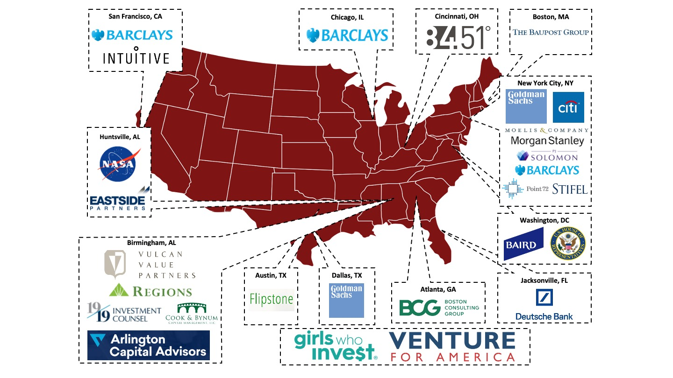
2021 CIMG Member Full Time& Internship Placement

Slide 8
Introduction to CIMG
CIMG’s History
Additional $500k added in Feb. 2020
CIMG founded in 2009 with $315K
CIMG’s Vision
We, the Culverhouse Investment Management Group, aspire to be the premier undergraduate, student-managed investment fund at The University of Alabama, in the State of Alabama, in the Southeast, and in the nation.

Slide 9
Faculty Advisor
John Heins, Fitzpatrick Endowed Professor of Value Investing
Email: jheins@culverhouse.ua.edu
Education: B.S., University of Pennsylvania; M.B.A., Stanford University
Current Roles:
President & Editor-in-Chief, Value Investor Media, Inc.
Previous Roles:
President & CEO, Gruner + Jahr USA Publishing
Senior Vice President, Personal Finance, AOL
Reporter, Forbes Magazine

Slide 10
Faculty Advisor
Zeke Ashton, Associate Director of the Fitzpatrick Center for Value Investing
Email: zashton@cba.ua.edu
Education: B.A., Austin College, Economics / German
Previous Roles:
Founder and Managing Partner, Centaur Capital Partners Portfolio Manager, Centaur Mutual Funds
Featured Writer, The Motley Fool
Project Manager, Infinity Systems, Zurich Project Manager, Wall Street Systems, Munich

Slide 11
Value Investing Opportunities at UA
Finance Major; Value Investing Specialization
The Value Investing concentration provides students with a strong foundation for examining the critical aspects of investing decisions, including generating good ideas, conducting fundamental business and industry research, analyzing financial statements, and credibly estimating what businesses and companies are worth. The focus is on practical applications. Students will be prepared for a broad range of business careers, including investment management, investment banking, private equity, management consulting, corporate business development, corporate finance and entrepreneurship. The Value Investing concentration is restricted to Finance majors only.
Value Investing Concentration |  | Hours
AC 444 | Financial Analysis – Investing | 3
FI 417 | Value Investing Principles | 3
FI 418 | Advanced Value Investing | 3
Total Hours |  | 9

Slide 12
What is Value Investing?
Notes:
Nick

Slide 13
What is Value Investing
Investing as a Business Owner
Main objective is to find stocks trading at less than their intrinsic value
This discount provides us a margin of safety (i.e. we can be wrong and still make money)
This can only be done with the belief that markets are mostly efficient
Value Investors view investing as buying a small part of a business
i.e. Purchasing one share of Amazon means you’re purchasing .0000002% of the company
As such, we spend our time researching the business more than the quantitative data
Some key traits of our successful investments include:
Businesses we understand
A strong moat
Competent management teams
Significant amount of free cash flow
“All intelligent investing is value investing- acquiring more than you are paying for. You must value the business in order to value the stock”
-Charlie Munger

Slide 14
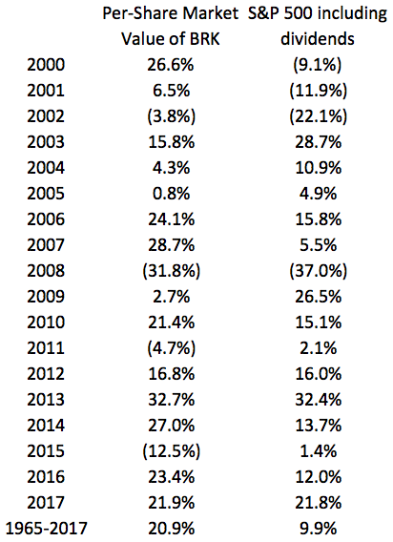
What is Value Investing?
Two Main Objectives of Value Investing
Minimize Risk
Earn Absolute Return
The two most important rules of investing:
Don’t lose money
Never forget rule number 1
We want to prevent permanent capital loss
A 50% return can be wiped out with a 33% loss
A 50% loss takes a 100% return to reset
Modern Portfolio Theory hypothesizes that in order to earn higher returns, one must take greater risk
Value investors don’t believe this
Our margin of safety protects some of our downside
Since markets are mostly efficient, we believe that the intrinsic value will ultimately be reflected
An added emphasis on value stability further reduces our downside
Market returns will ebb and flow, so we want to focus on earning consistent, long-term absolute returns
We want to do our best to ignore short-term market gyrations and compound our returns over time

Slide 15
Value Investing with CIMG
Investment Philosophy
Value Investing
The Concept of Intrinsic Value
CIMG believes that businesses have an appraisable intrinsic value that solely depends on the future cash flows that business can be expected to produce.
The Assumption of Inefficient Markets
CIMG believes that market prices frequently detach from intrinsic value, offering opportunities for investors to buy securities for less than they are worth and achieve better returns with less risk.
The Requirement of a Margin of Safety
CIMG only invests when it believes the gap between market price and intrinsic value is so large that it should overcome any assumptions about the future that may prove mistaken.
The Importance of a Quality Business
CIMG prioritizes quality businesses by overweighting them in our portfolio ceteris paribus. We mostly agree that a great business at a fair price is better than a fair business at a great price.
The Necessity of Investing with an Edge
CIMG believes that to beat the market, one needs to discern what makes their investment process better than their peers, either on an informational, analytical, or behavioral basis.

Slide 16
Value Investing Today

Slide 17
Value Investing Today
Value Investing Historically Underperforms in Sector-Driven Bull Markets
Investors Get Greedy
Oct. 24th, 2017 CNBC Article
The current market has been driven by technology and growth stocks
The FAANG stocks have returned 28.44% annually since September of 2014
Investors will question why they are value investors while all of their friends are getting rich
“Only when the tide goes out do you discover who has been swimming naked” – Warren Buffett
Value outperforms over time, but not recently…
Annualized Extra 10-yr Return from US Value over Growth
Value
Growth
Value
Growth
MSCI Value
MSCI Growth

Slide 18
Where Can “Value” Ideas be Found?

Slide 19
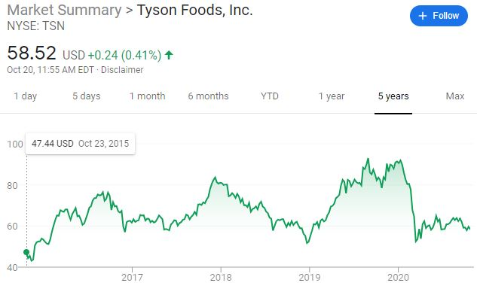
Opportunities for Mispricing
There are a few common reasons stocks get mispriced… The most basic:
Market Cycles
S&P500—market index
Markets can become overly optimistic or pessimistic about the future
When things look bad, investors often think the worst
When things look good, investors often think it will stay that way forever
??
Industry Cycles
Tyson Foods (TSN)—chicken producer
Many industries go through cycles driven by supply and demand
Almost always commodity business
Energy, lumber, meat, etc.
Industry cycles are often very complex with a lot of moving parts, but great research can provide clarity
Great example in the footnote!
https://www.sohnconference.org/wp-content/uploads/2019/05/TariqBarma_SohnIdeaContest2019.pdf

Slide 20
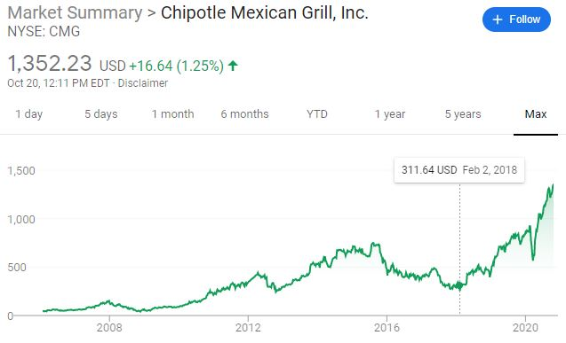
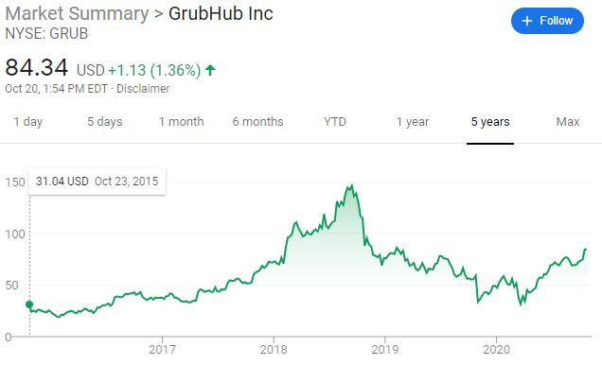
Opportunities for Mispricing
There are a few common reasons stocks get mispriced… The more granular:
Bad News
Chipotle (CMG)—2015 E. coli outbreak
Sep. 2015 to Feb. 2018, down ~60%
Feb. 2018 to Today, up 300%+
Markets overreact to bad news (and good news) all the time
Often times, headline news doesn’t impact the long-term value of a business
Next quarter, year, two years, could be bad, but long-term might be fine
??
Down ~60%
Uncertainty
Grubhub (GRUB)—food delivery
Uncertainty around profit potential of the delivery business
Management guiding for underwhelming performance in the short term
Even a short report out on the company
When investors don’t know what to make of a situation, sometimes they avoid it altogether
Up 160%+
Start of the major uncertainty

Slide 21
Next week, further research & reading recommendations

Slide 22
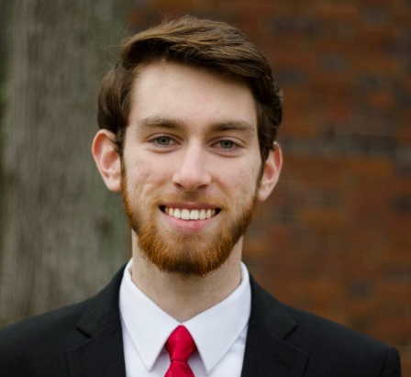
Value Investing Seminars
Culverhouse Investment Management Group
Schedule of VIS
Contact Information
Date | Topic
Oct. 5th | Intro to Value Investing- Overview, Warren Buffet, Ben Graham, strategy, margin of safety
Oct. 12th | Research, Company & Industry Analysis
Oct. 19th | Accounting- Financial statements, cash vs. accrual, profit, margins, growth
Oct. 26th | Intro to Valuation- Relative & Intrinsic Valuation
Ben Silvey
President
basilvey@crimson.ua.edu
Nick Parsons
VP of Portfolio Management
njparsons@crimson.ua.edu

Slide 23
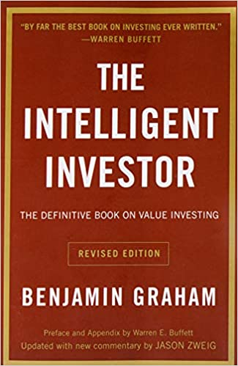
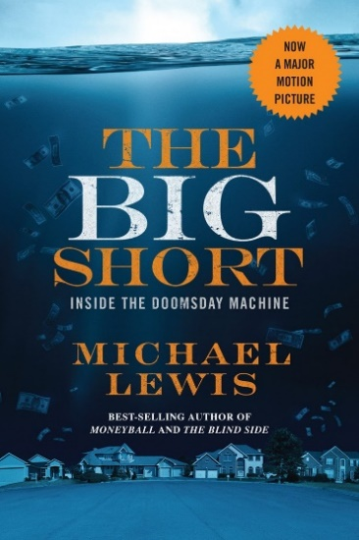
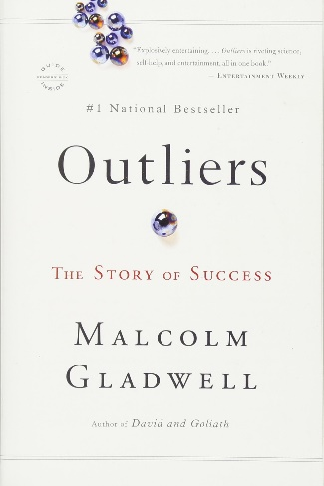
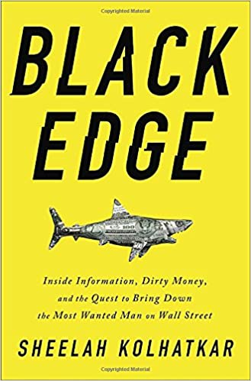
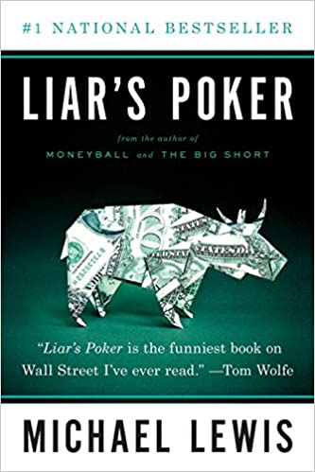
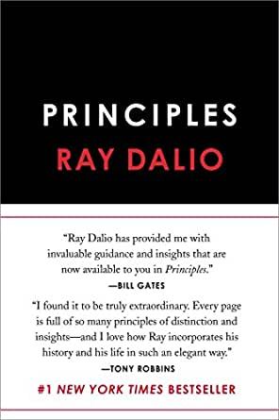
Areas for Further Research / Book Recs
Warren Buffett Archive
Howard Marks Letters
Vulcan Value Partners Letters
Horizon Kinetics letters
Foundation Resource Management Insights
Wall Street Journal
Investopedia
Dealbook – NYT
Axios Pro Rata
Morning Brew

Slide 24
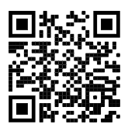
VIS Attendance

