Slide 1
Value Investing Seminar #3:
Accounting For Value Investing
March 23rd, 2021
Ben Silvey
President, CIMG
Connor Dessert
Vice President of Investment Research, CIMG

Slide 2
Table of Contents
Introducing ourselves & CIMG
Value investing opportunities at UA
The Income Statement
The Cash Flow Statement
The Balance Sheet
Key Concepts, Terminology, and Documents

Slide 3
CIMG Board of Directors 2021-2022
Ben Silvey, President
Year: Senior
Hometown: Beavercreek, OH
Majors: Finance and Economics (Value Investing and Creative Media)
Semesters in CIMG: 5
Full Time: Investment Banking Analyst – Solomon Partners
Internship Experience:
2021 – Investment Banking Summer Analyst – Solomon Partners
2020 – Equity Research Intern – Vulcan Value Partners
2019 – Research Intern – Ray|Theil Wealth Management

Slide 4
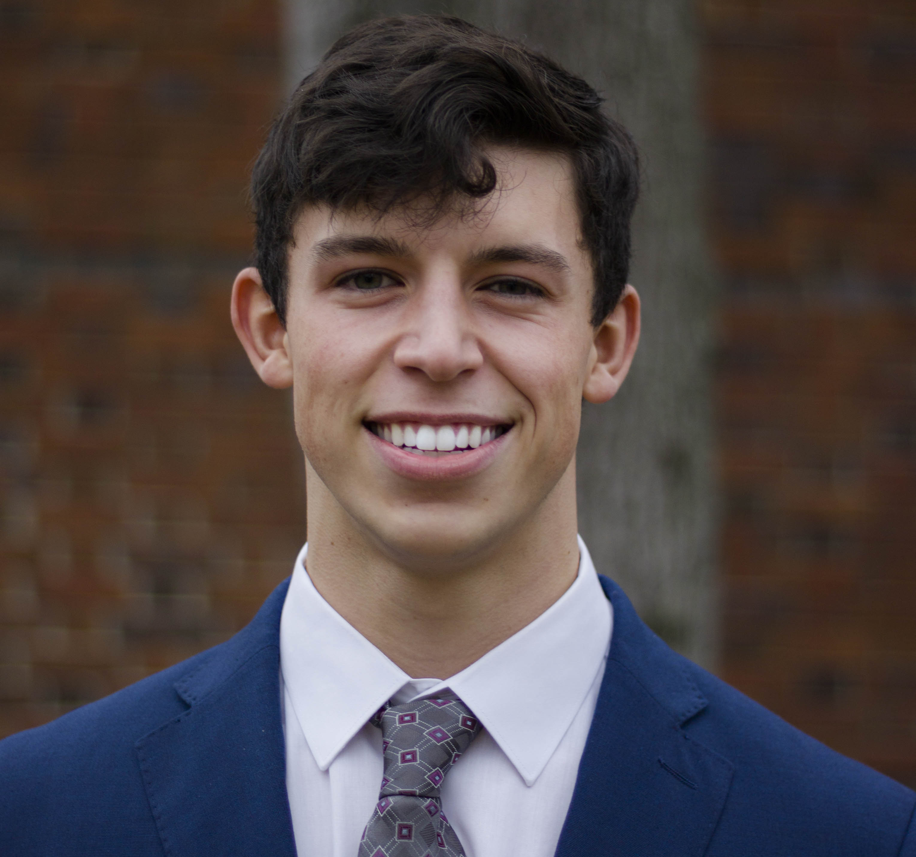
CIMG Board of Directors 2021-2022
Connor Dessert, Vice President of Investment Research
Year: Senior
Hometown: Moline, IL
Majors: Mathematics, Finance, Economics
Semesters in CIMG: 7
Full Time: Goldman Sachs Global Investment Research
Internship Experience:
2021 – Goldman Sachs Global Investment Research
2021 – Massif Capital
2020 – Cook & Bynum Capital Management

Slide 5
Value Investing Seminars
Culverhouse Investment Management Group
Schedule of VIS
Overview
Date | Topic
Oct. 5th | Intro to Value Investing- Overview, Warren Buffet, Ben Graham, strategy, margin of safety
Oct. 12th | Research, Company & Industry Analysis
Oct. 19th | Accounting- Financial statements, cash vs. accrual, profit, margins, growth
Oct. 26th | Intro to Valuation- Relative & Intrinsic Valuation
Designed to provide a comprehensive overview on:
Value Investing strategy
Opportunities at UA
Research
Company & Industry analysis
Financial statement analysis
Practical valuation concepts

Slide 6
Value Investing Opportunities at UA

Slide 7
Culverhouse Investment Management Group
Basic Information
CIMG was founded in 2009 by four BHP members
Founding members were Rodrigo Flores, Brad Green, Caitlin Sims, and Scott Peters
Initial capital was donated by Culverhouse alumni in the amount of $315,000
Current portfolio is worth more than $1,600,000 managed by ~60 members
Long-only (no shorting stocks)
Equity-only (no trading in debt, currencies, derivatives, etc…)
Value-oriented (avoid momentum or high growth stocks e.g. TSLA)
CIMG has an Advisory Board of professional investors
Our Advisory Board visits Tuscaloosa once per semester to get updates on the group and give feedback on our investment ideas
Members are taught and practice a variety of quantitative and qualitative analysis
techniques to value companies and make intelligent investment decisions
The group prepares young professionals for careers in equity research, investment banking, management consulting, and other areas of the financial industry

Slide 8
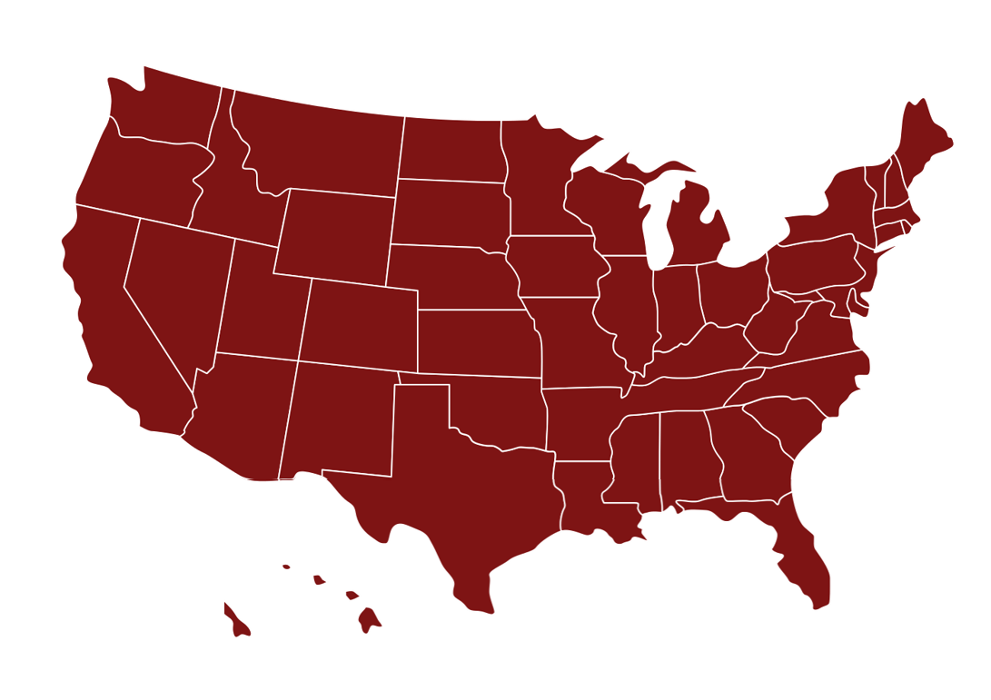
2021 CIMG Internship & Full Time& Internship Placement
San Francisco, CA
Chicago, IL
Cincinnati, OH
Boston, MA
New York City, NY
Huntsville, AL
Washington, DC
Birmingham, AL
Austin, TX
Dallas, TX
Jacksonville, FL
Atlanta, GA

Slide 9
Introduction to CIMG
CIMG’s History
CIMG Assets Under Management (AUM)
CIMG vs. S&P 500 Cumulative Return
Additional $500k added in Feb. 2020
$1.65m
293%
CIMG founded in 2009 with $315K
195%
CIMG’s Vision
We, the Culverhouse Investment Management Group, aspire to be the premier undergraduate, student-managed investment fund at The University of Alabama, in the State of Alabama, in the Southeast, and in the nation.

Slide 10
Faculty Advisor
John Heins, Fitzpatrick Endowed Professor of Value Investing
Email: jheins@culverhouse.ua.edu
Education: B.S., University of Pennsylvania, M.B.A., Stanford University
Current Roles:
President & Editor-in-Chief, Value Investor Media, Inc.
Previous Roles:
President & CEO, Gruner + Jahr USA Publishing
Senior Vice President, Personal Finance, AOL
Reporter, Forbes Magazine

Slide 11
Faculty Advisor
Zeke Ashton, Associate Director of the Fitzpatrick Center for Value Investing
Email: zashton@cba.ua.edu
Education: B.A., Austin College, Economics / German
Previous Roles:
Founder and Managing Partner, Centaur Capital Partners
Portfolio Manager, Centaur Mutual Funds
Featured Writer, Motley Fool
Project Manager, Infinity Systems, Munich
Project Manager, Wall Street Systems, Munich

Slide 12
Value Investing Opportunities at UA
Finance Major; Value Investing Specialization
The Value Investing concentration provides students with a strong foundation for examining the critical aspects of investing decisions, including generating good ideas, conducting fundamental business and industry research, analyzing financial statements, and credibly estimating what businesses and companies are worth. The focus is on practical applications. Students will be prepared for a broad range of business careers, including investment management, investment banking, private equity, management consulting, corporate business development, corporate finance and entrepreneurship. The Value Investing concentration is restricted to Finance majors only.
Value Investing Concentration |  | Hours
AC 444 | Financial Analysis – Investing | 3
FI 417 | Value Investing Principles | 3
FI 418 | Advanced Value Investing | 3
Total Hours |  | 9

Slide 13
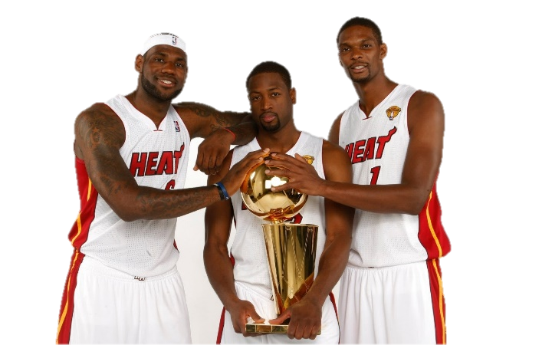
“The Big 3” Financial Statements

Slide 14
“The Big 3” Financial Statements
Financial Statements summarize company’s performance
Income Statement
Summarizes revenue and expenses for a period of time
Reports the profit performance of a business (items for a period of time and impact the company’s taxes)
Cash Flow Statement
Reports the sources of a business’s cash inflows and outflows between two balance sheet dates
Shows changes in a firm’s investments and financial structure
Balance Sheet
Reports the balance of assets, liabilities and equity at a precise moment in time
Shows the financial condition of the business

Slide 15
The Income Statement

Slide 16
Income Statement
Income statement
Sales | X
Cost of goods sold (COGS) | (X)
Gross profit | X
Selling, general and administrative (SG&A) | (X)
Operating profit | X
Interest/finance expense | (X)
Profit before tax | X
Tax expense | (X)
Net income | X
“Top line”
Costs to make/buy the product
Costs to support the business
“EBIT,” or “Earnings before interest and taxes”
”EBT,” or “Earnings before taxes”
“Bottom line”

Slide 17
Income Statement
For a PERIOD of time
Sales and associated expenses
BS End Period 0
Income statement for period 1
BS End Period 1

Slide 18
The Cash Flow Statement

Slide 19
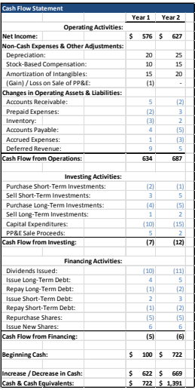
“The Big 3” Financial Statements
Purpose of the Cash Flow Statement
Purpose
Reconcile the change in cash for the period
Adjustments to net income to reflect sources and uses of cash
Three Main Areas
Cash Flow From Operating Activities
Indicates the amount of cash generated from core business activities
Cash Flow From Investing Activities
Shows where cash was used for investments
Cash Flow From Financing Activities
Reports sources and uses of financing for operating and investing activities

Slide 20
Cash Flow Statement
Cash flow statement
Cash flow from operating activities | X
Cash flow from investing activities | (X)
Cash flow from financing activities | X
Net cash flow | (X)
Money from ongoing regular business activities
Money invested in long-term operating and financial assets
Money raised from, or paid to, debt and equity investors
The cash flow statement explains the change in cash over a period

Slide 21
The Balance Sheet

Slide 22
Accounting Equation
Balance sheet – at a point in time
Describes financial position
Liabilities
Assets
Assets = Liabilities + Equity
Equity
Must always balance!

Slide 23
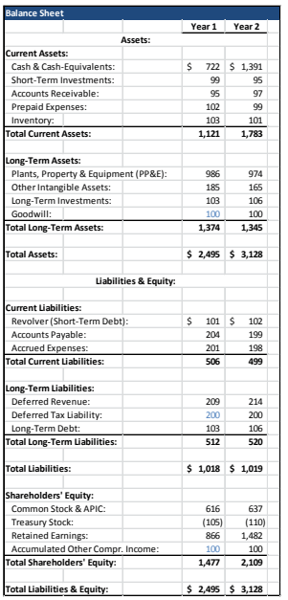
“The Big 3” Financial Statements
Balance Sheet
“Snapshot” of Financial Position
Ending Balances ONLY: Not a summary of transactions
Annual Report: Last two years
10Q: Most recent balance sheet and previous year
Timing of When Items Are “Due” Is Key
“Current” = Due within one year
Assets: Turned into cash within one year
Liabilities: Payable within one year
“Long-Term” = Due after one year
MUST BALANCE: A = L + E
Assets = what is owned by the company or what is due
Liabilities = what the company owes
Equity = shareholders ownership
Also called “Book Value”

Slide 24
Balance Sheet
Key sources of financing
Debt
Equity
Debtholders = “lenders”
Shareholder = “owners”

Slide 25
Balance Sheet
Key sources of financing
Debt
Equity
Debtholders = “lenders”
Shareholder = “owners”
Receive interest
Principal repaid
Senior creditor
Receive dividend
Perpetual investment
Residual claim

Slide 26
Key Concepts

Slide 27
How the 3 Statements Connect

Slide 28
Key Terminology & Documents
Key Terminology
COGS - Cost of Goods Sold
Gross Profit - Revenue Less COGS
SG&A - Selling, General & Administrative Costs
R&D - Research and Development
OpEx - Operating Expenses (Sum of expenses)
EBIT - Earnings Before Interest and Taxes (same thing as Operating Income)
NOPAT - Net Operating Profit After Tax
CapEx - Capital Expenditures
Note: Some companies label things differently.
Key SEC Documents
10-K – Comprehensive yearly analysis of the company
10-Q – Unaudited quarterly report updating the 10-K
8-K – Report filed announcing events investors should know about
Proxy Statements – Issues to be discussed at shareholder meetings

Slide 29
Next Week

Slide 30
Value Investing Seminars
Culverhouse Investment Management Group
Schedule of VIS
Contact Information
Date | Topic
Oct. 5th | Intro to Value Investing- Overview, Warren Buffet, Ben Graham, strategy, margin of safety
Oct. 12th | Research, Company & Industry Analysis
Oct. 19th | Accounting- Financial statements, cash vs. accrual, profit, margins, growth
Oct. 26th | Intro to Valuation- Relative & Intrinsic Valuation
Ben Silvey
President
basilvey@crimson.ua.edu
Connor Dessert
VP Investment Research
chdessert@crimson.ua.edu

Slide 31
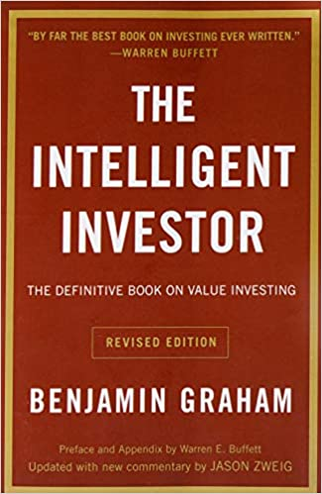
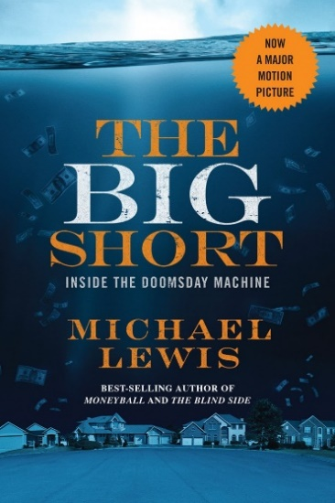
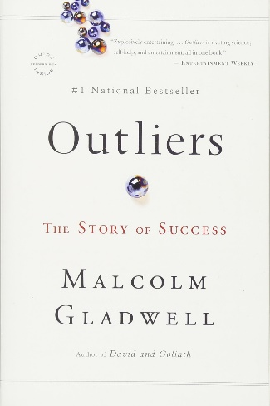
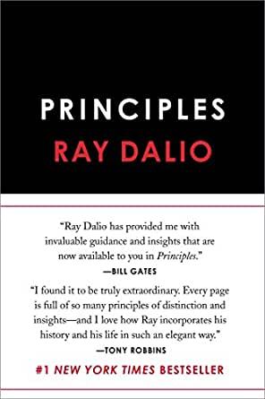
Areas for Further Research / Book Recs
Warren Buffett Archive
Howard Marks Letters
Vulcan Value Partners Letters
Horizon Kinetics letters
Foundation Resource Management Insights
Wall Street Journal
Investopedia
Yet Another Value Blog
Nomad Investment Partnership Letters

